Slide 1

CSE347
Information System Analysis and Design
Md Sabbir Hossain
Lecturer
Department of Computer Science and Engineering
Faculty of Science and Engineering

Slide 2
Topic
Deployment Diagram
2

Slide 3
Why We Need Deployment Diagrams
What existing systems will system need to interact or integrate with?
How robust does system need to be (e.g., redundant hardware in case of a system failure)?
What and who will connect to or interact with system, and how will they do it?
What middleware, including the operating system and communications approaches and protocols, will system use?
What hardware and software will users directly interact with (PCs, network computers, browsers, etc.)?
How will you monitor the system once deployed?
How secure does the system need to be (needs a firewall, physically secure hardware, etc.)?

Slide 4
Deployment Diagrams
Show the structure of the run-time system
Capture the hardware that will be used to implement the system and the links between different items of hardware
Model physical hardware elements and the communication paths between them
Plan the architecture of a system
Document the deployment of software components or nodes

Slide 5
Deployment Diagrams
Show the configuration of run-time processing elements and the software components, processes, and objects
Software component instances represent run-time manifestations of code units
Capture only components that exist as run-time entities
Show the systems hardware, the software installed on that hardware, and the middleware that connects the disparate machines together
A collection of one or more deployment diagrams with their associated documentation
Show the physical configurations of software and hardware

Slide 6
What is a Deployment Diagram?
Deployment Diagram – a diagram that shows the physical relationships among software and hardware components in a system
Components – physical modules of code
Connections – show communication paths
Dependencies – show how components communicate with other components
Nodes – computational units, usually a pieces of hardware
Show physical deployment of artifacts on nodes.
To describe a web site, for example, a deployment diagram would show
what hardware components ("nodes") exist (e.g., a web server, an application server,
and a database server),
what software components ("artifacts") run on each node (e.g., web application, database), and
how the different pieces are connected (e.g. JDBC, REST, RMI).

Slide 7
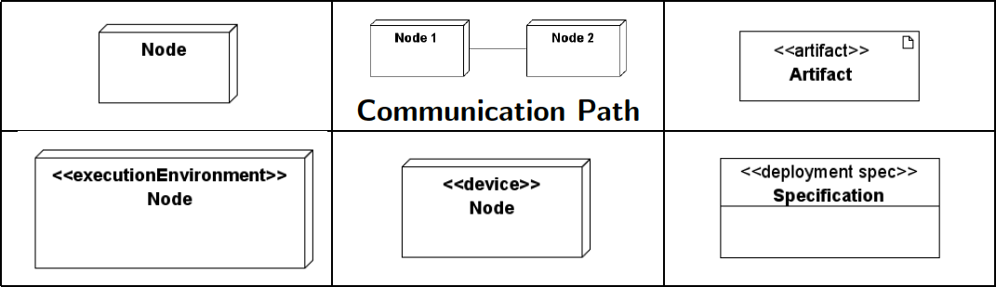
Deployment Diagrams

Slide 8
DEPLOYMENT DIAGRAMS
There is a strong link between deployment diagrams
Deployment diagrams
components diagrams and
Show the physical relationship between hardware and software in a system
Hardware elements:
Computers (clients, servers)
Embedded processors
Devices (sensors, peripherals)
Are used to show the nodes where software components reside in the run-
time system

Slide 9
DEPLOYMENT DIAGRAMS
Deployment diagrams specify constructs that can be used to define:
the execution architecture of systems and
the assignment of software artifacts to system elements.
Nodes in deployment diagrams represent either hardware devices or software execution environments.
Artifacts are deployed over nodes
Some item of information that is used or produced by a software development process or by operation of a system. Examples: model files, source files, scripts, executable files, database tables, development deliverables, word processing documents, and mail messages.

Slide 10
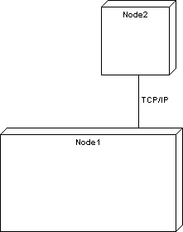
DEPLOYMENT DIAGRAMS
Deployment diagram
Contains nodes and connections
A node usually represent a piece of hardware in the system
A connection depicts the communication path used
by the hardware to communicate
Usually indicates the method such as TCP/IP

Slide 11
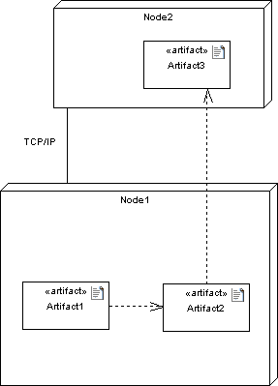
DEPLOYMENT DIAGRAMS
Deployment diagrams contain artifact
An artifact
Is the specification of a phisycal piece of information
Ex: source files, binary executable files, table in a database system,….
An artifact defined by the user represents a concrete element in the physical world

Slide 12
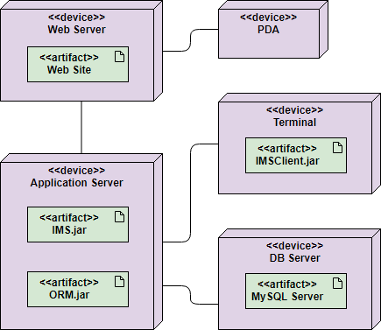
DEPLOYMENT DIAGRAMS

Slide 13
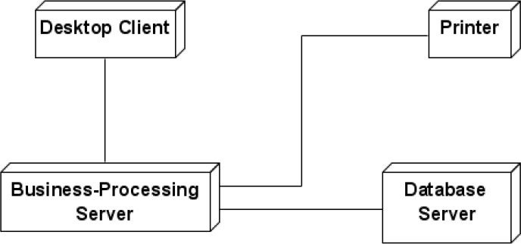
Communication Association
A communication associations between nodes indicates a communication path between the nodes that allows components on the nodes to communicate with one another.

Slide 14
UML 2 Deployment Diagrams - nodes
Two node types:
Device
a physical computational resource with processing capability (memory and services to execute software) upon which artifacts may be deployed for execution. For example, typical computers or mobile phones.
Execution environment
a node that offers an execution environment for specific types of components that are deployed on it in the form of executable artifacts.
software computing resource that runs within an outer node and which itself provides a service to host and execute other executable software elements.

Slide 15
UML 2 Deployment Diagrams - nodes
The nodes appear as boxes, and the artifacts allocated to each node appear as rectangles within the boxes.
Nodes may have sub-nodes, which appear as nested boxes.
A single node in a deployment diagram may conceptually represent multiple physical nodes, such as a cluster of database servers.

Slide 16
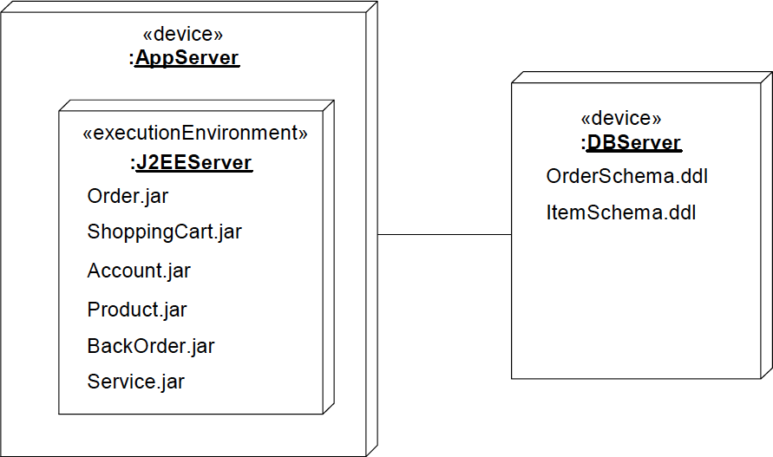
UML 2 Deployment Diagrams - nodes

Slide 17
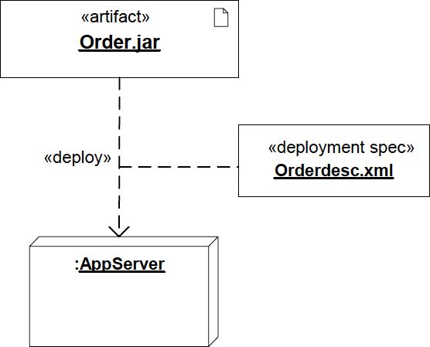
Deployment Specification
A deployment diagram can have a deployment specification

Slide 18
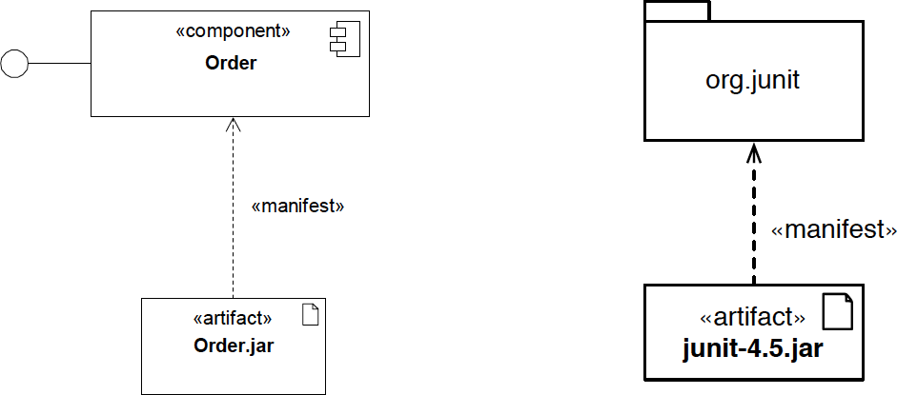
Manifestation
Artifacts can packageable components
now manifest any element, not just
Manifestation (the concrete physical rendering of one or more model elements by an artifact) is shown by a dependency with keyword «manifest»

Slide 19
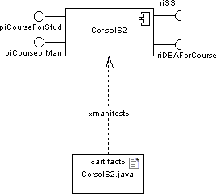
Manifestation
An artifact manifest one or more model elements
A <<manifestation>> is the concrete physical of one or more model elements by an artifact
This model element is often a component
A manifestation is notated as a dashed line with an open arrow-head labeled with the keyword <<manifest>>

Slide 20
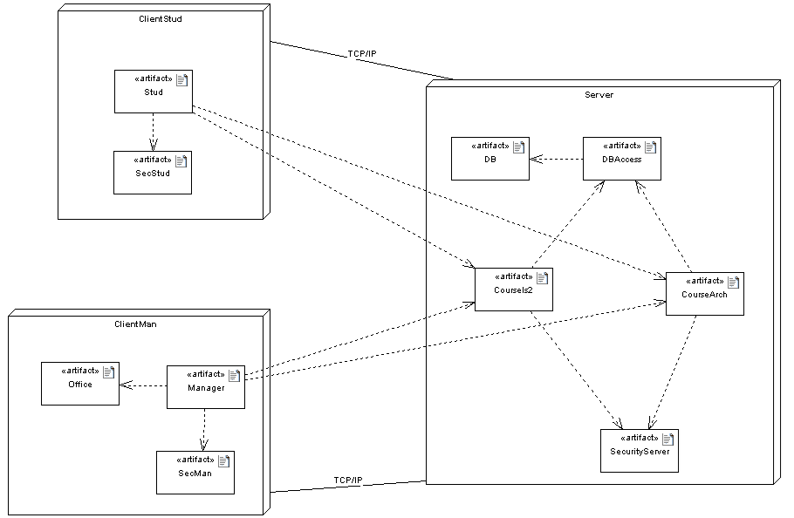
DEPLOYMENT DIAGRAMS

Slide 21
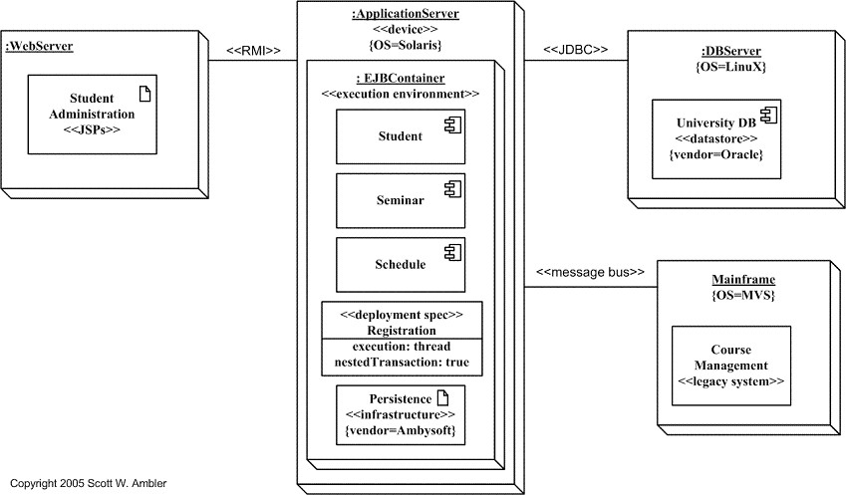
Deployment Diagrams

Slide 22
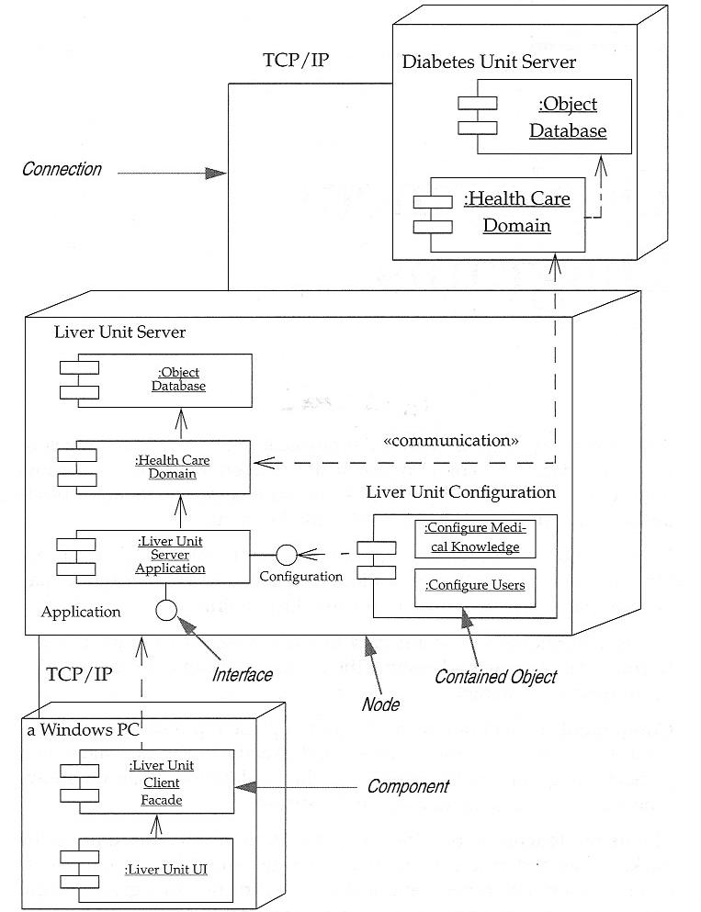
Deployment Diagrams Example
22

Slide 23
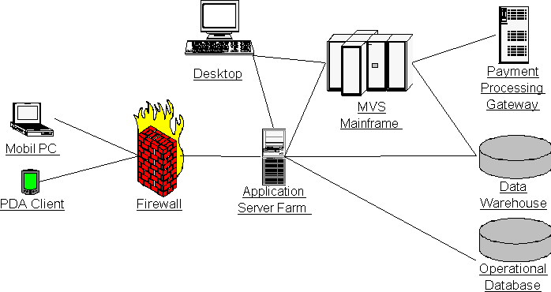
System Architecture

Slide 24
Deployment Planning
How will your system be installed?
If different versions of the system will be in production at the same time, how will you resolve differences?
What physical sites do you need to deploy to and in what order?
How will you train your users?

Slide 25
Deployment Planning
How will your system be installed?
Who will install it? How long should it take to install?
Where the installation possibly fail? How do you back out if the installation fails? How long does it take to back out?
What is your installation window (during what time period can you install
your system)?
What backups do you need before installation? Do you need to do a data conversion?
How do you know that the installation was successful?

Slide 26
Deployment Planning
What physical sites do you need to deploy to and in what order?
What physical sites do you need to deploy to and in what order?
How will you train your support and operations staff?
Do you need to deploy a production support system so that the support staff uses their own environment to simulate problems?
How will you train your users?
What documentation, and in what formats and languages, do your users, and support and operation staff need?
How will updates to documentation be deployed?

Slide 27
How to Produce Deployment Diagrams
Decide on the purpose of the diagram
Add nodes to the diagram
Add communication associations to the diagram
Add other elements to the diagram, such as components or active objects, if required
Add dependencies between components and objects, if required

Slide 28
Allocating Artifacts to Nodes
Consider a number of aspects when allocating components to nodes, e.g.:
Resource usage
Geographical location
Access to devices
Security
Performance
Extensibility and portability

Slide 29
Modelling Business Process
Business modelling using nodes and components is an effective means of capturing non-computer based processes and entities
This can be done very early in development, to complement the use case model and other business modelling
Components are the business procedures and documents; the nodes (\run-time structure") are the organisation units and resources (human and other) of the business

Slide 30
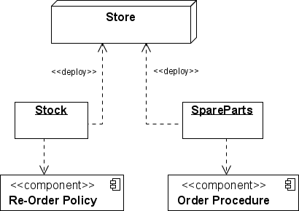
Modelling Business Process

Slide 31
Example of a Deployment diagram
A deployment diagram for the Apple iTunes application:
The iTunes setup can be downloaded from the iTunes website, and also it can be installed on the home computer. Once the installation and the registration are done, iTunes application can easily interconnect with the Apple iTunes store. Users can purchase and download music, video, TV serials, etc. and cache it in the media library.
Devices like Apple iPod Touch and Apple iPhone can update its own media library from the computer with iTunes with the help of USB or simply by downloading media directly from the Apple iTunes store using wireless protocols, for example; Wi-Fi, 3G, or EDGE.

Slide 32
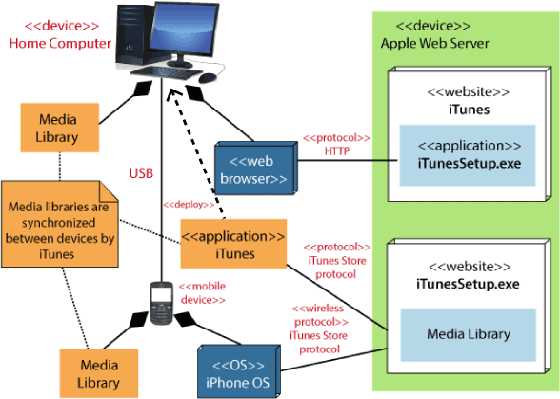
A deployment diagram: Apple iTunes Application

Slide 33
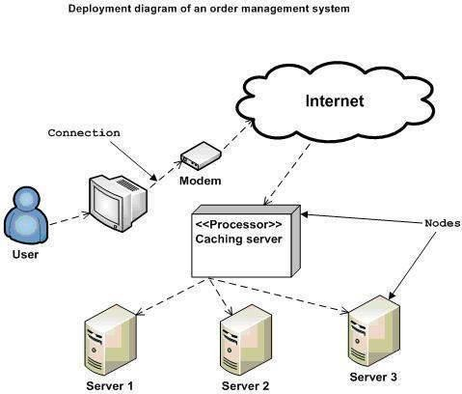
Deployment diagram: Order Management System

Slide 34
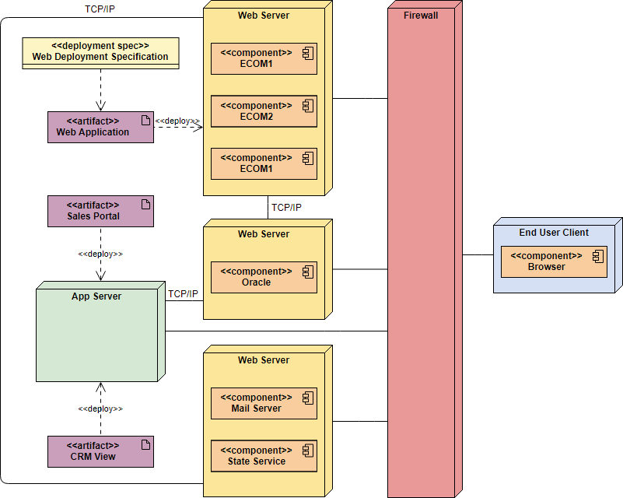
Management Information System for a SME

Slide 35
Exercise: ATM System
To deploy the software to an Automated Teller Machine, there are two application servers. In the first application server, the ATM Network Server component is deployed. In the other server, the Bank component is deployed. These two servers are connected by a T-1 network connection. The first server is connected to the device of the ATM booth a T-1 network connection, contains the Display, Keypad, and Cash Dispenser are deployed. The processor of the device is Zilog Z80 at 3.5 and 7 MHz (turbo mode), RAM is 512KB, and ROM is 128 KB. There should be two additional devices. One device will have a Card Reader component and receipt printer and the SMS sender component will be deployed to another device. Both devices are connected to the ATM by message bus (wired connection).

